Slide 1
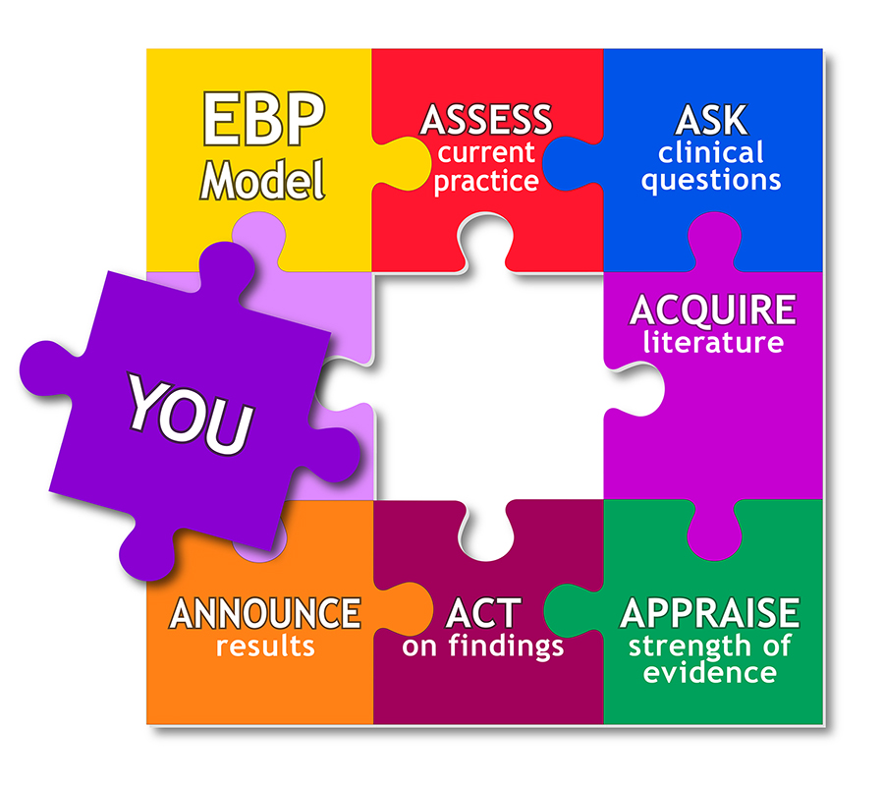
Evidence Based Approaches
Week 9-Slide
Evidence based Approaches

Slide 2

Aim;
To Conduct a review of key literature relating to a research topic towards improvements in care practice.
Learning Outcomes;
Explore the structure of a literature review
Evaluate the reliability and validity of own literature review
Explain the Boolean methods can be used to narrow search

Slide 3


Slide 4

Getting Started
Once you are clear on what specific areas/issues your literature review will cover, you should start by searching for relevant reading material.
You should aim to use a variety of different types of sources, which can include, but is not limited to:

Slide 5

Writing the Literature Review
Keep your audience / reader in mind – be sure to write to the level of your reader
Use subheadings to clarify your structure – it will make your review more manageable to read and “chunks” the information
Use evidence
Be selective – pick the most important points from each source
Paraphrasing is preferred to using many direct quotes – this allows you to use your own voice and show your understanding of the research
Do not cite references you have not read

Slide 6

Structuring the Literature Review
The main part of your literature review will be the discussion and analysis of the literature.
You should also include an introduction to the main discussion as well as a conclusion that summarises the key points of the discussion.
Below is an overview of how you could structure your literature review.

Slide 7

In your literature review you will normally be expected to:
• Identify and group together common issues/themes/areas of discussion Identify and group together similar studies
• Compare, contrast and evaluate research/themes/issues
• Identify how research/themes/issues have developed over time as well as the current state of research
• Identify gaps in research and areas for further study
• Demonstrate why your dissertation topic and research is relevant to your field of study

Slide 8

Structuring the Literature Review
Introduce your literature review by:
• Outlining the wider context of your literature review – where/how does your dissertation topic fit in to the wider subject area
• Outlining the scope of your literature review – sources, areas to be discussed
• Outlining how and why you have selected the literature to be reviewed
• Providing a rationale – i.e. reason and aims – for reviewing the literature on the specific topic

Slide 9

Contd…
Form the main discussion of your literature review by:
Analysing and evaluating the themes, issues, propositions (=suggestions, conclusions, opinions of authors) found in the literature
Synthesising (=drawing together/combining) common themes, issues, propositions to enable you to draw reasoned conclusions
Comparing and contrasting themes, issues, propositions, research outcomes Language tip: Use linking words to help with signposting

Slide 10

Conclude your literature review by:
Concluding how your literature review has met the aims outlined in your introduction
Summarising and synthesising the main issues/themes related to your topic area and research questions as identified in the literature
Suggesting areas of further study
Outlining implications and significance of the identified themes/issues for your dissertation topic and field of study
Identifying why and how your own research will aim to address the gaps identified – providing a rationale for your chosen dissertation topic

Slide 11
Structure of a literature review
Like essays, a literature review must have an introduction, a body and a conclusion.
The structure of a literature review
Introduction- The introduction should: define your topic and provide an appropriate context for reviewing the literature; ...
Main body- The middle or main body should: organise the literature according to common themes; ...
Conclusion- The conclusion should: summarise the important aspects of the existing body of literature (The Royal Literary Fund, 2019).

Slide 12
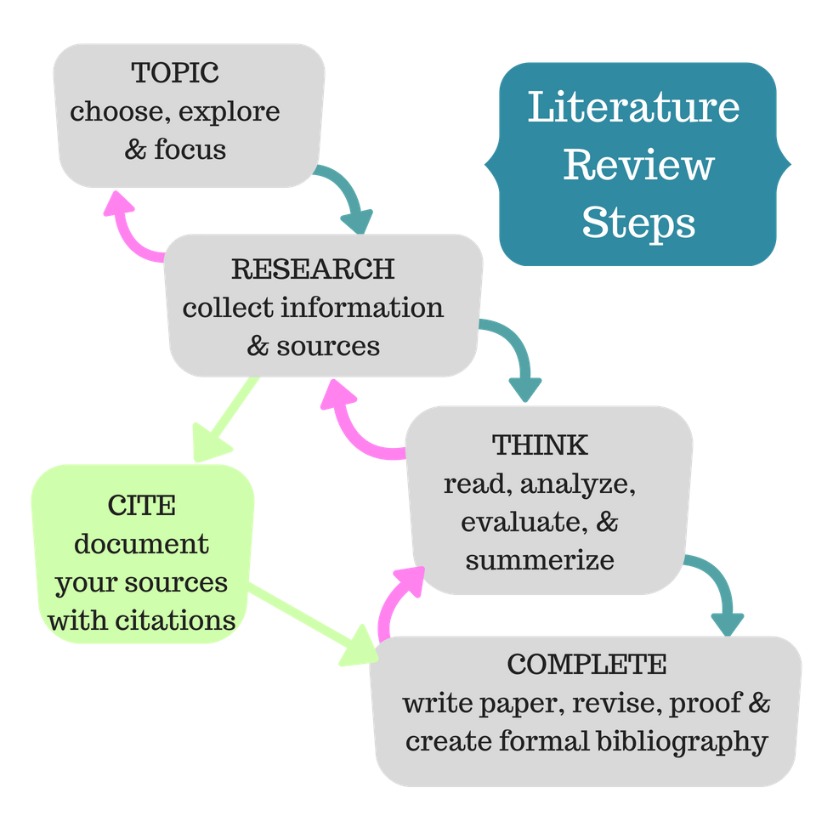
(Uscupstate.libguides.com, 2019)

Slide 13

Conducting a literature review using various resources – secondary sources
Textbooks
Specialist books
Journals
Sector magazines
Commissioned reports
Regulator reports
Government organisation websites
Google Scholar
WWW
NHS
Charities
Leaflets
Social media
Pubmed

Slide 14

Activity (10 minutes)
Individually,
Identify and Explain the MAIN structure of a literature review i.e., Introduction, main body and conclusion
Feedback to the class
https://youtu.be/kW6Uzn-8uMI
Just like any other academic text, your literature review should have an introduction, a main body, and a conclusion.
In this video, you’ll learn what to include in each section, as well as 4 tips for the main body illustrated with an example.

Slide 15


10 minutes break

Slide 16
Organising your literature review

Slide 17

Individually / small group activity (10 minutes)
Working in small group, with extracts from the video clip,
Identify and Explain the Ways to Organize Your Literature Review
Group present feedback.
All you do is:
Gather the summaries of your sources.
Put the summaries in groups based on theme.
Turn each group into a paragraph with a topic sentence and transitions between each source.
Add introduction and conclusion paragraphs.
You're done! Here is a simple demonstration of the procedure:
https://youtu.be/UoYpyY9n9YQ
http://www.peakwriting.com/litreview/...

Slide 18
Ways to Organize Your Literature Review
Chronologically
By author
Different theoretical approaches
Specific concepts or issues
Different methodologies
Level of support to your hypothesis/theory/topic of review

Slide 19
Academic Phrasebank - The University of Manchester
https://www.phrasebank.manchester.ac.uk

Slide 20
Research the meaning of reliability and validity
Explain the difference between reliability and validity
https://youtu.be/fnF2hrLZHoA

Slide 21

What is reliability?
EXAMPLE:
You measure the temperature of a liquid sample several times under identical conditions.
The thermometer displays the same temperature every time, so the results are reliable.
A doctor uses a symptom questionnaire to diagnose a patient with a long-term medical condition.
Several different doctors use the same questionnaire with the same patient but give different diagnoses.
This indicates that the questionnaire has low reliability as a measure of the condition (Scribbr, 2019).

Slide 22

Research reliability
In simple terms, research reliability is the degree to which research method produces stable and consistent results. A specific measure is considered to be reliable if its application on the same object of measurement number of times produces the same results (Golafshani, 2003).

Slide 23
Reliability refers to how consistently a method measures something.
If the same result can be consistently achieved by using the same methods under the same circumstances, the measurement is considered reliable.
Reliability and validity are closely related, but they mean different things.
A measurement can be reliable without being valid. However, if a measurement is valid, it is usually also reliable.

Slide 24
Focusing on reliability and validity
Reliability and Validity activity
Reliability and validity are concepts used to evaluate the quality of research. They indicate how well a method, technique or test measures something.
Reliability is about the consistency of a measure, and validity is about the accuracy of a measure.
For research and testing, there are subtle differences. Reliability implies consistency: if you take the ACT five times, you should get roughly the same results every time. A test is valid if it measures what it's supposed to. Tests that are valid are also reliable (Scribbr, 2019).

Slide 25

What is validity
In general, VALIDITY is an indication of how sound your research is. More specifically, validity applies to both the design and the methods of your research.
Validity in data collection means that your findings truly represent the phenomenon you are claiming to measure. (Golafshani, 2003).

Slide 26
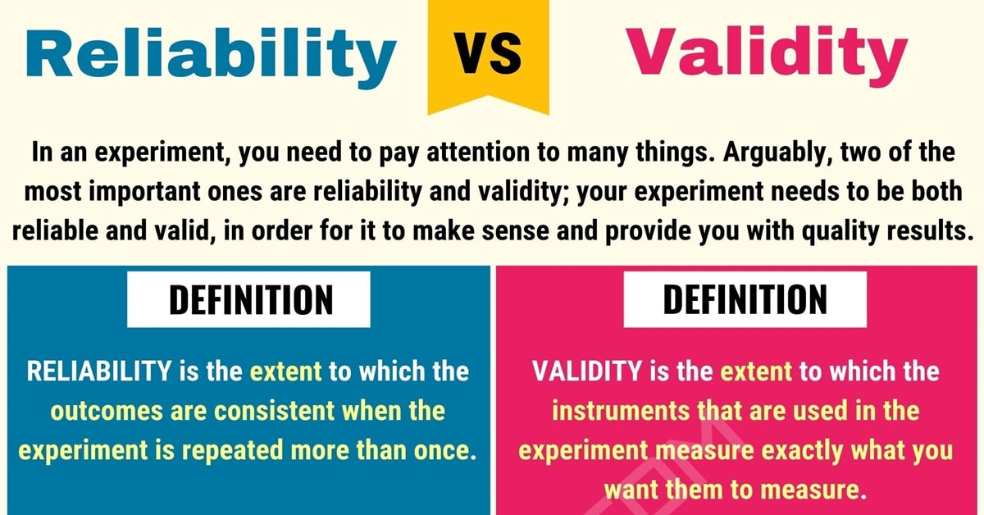

Slide 27
Validity and Reliability
In research terms, reliability refers to consistency. Just as you can count on the consistency of your friend, when something is reliable in science this indicates some level of consistency.
In science, validity refers to accuracy; if something is not accurate, it is not valid (Golafshani, 2003).

Slide 28
Boolean Search Modifier: QUOTATION MARKS ”

Slide 29
With extracts from the video clips,
Explain how to search using Boolean operators
Group feedback with examples
This video will show you the best tips and tricks to narrow down and find relevant literature fast.
https://youtu.be/u0KVJ0lj8rw
Intro - 00:00​
1. List out keywords - 0:17​
2. Search databases - 0:47​
3. Boolean operators (list out synonyms) - 1:08​
4. Boolean operators (Google Scholar search) - 1:24​
5. Identify important publications - 2:32
Activity

Slide 30

Boolean Search Modifier: QUOTATION MARKS ” “
Boolean methods can be used on any search engine:
Google, LinkedIn, or even Facebook. Boolean is a term used to define the process of combining keywords with words called “operators.”
These operators tell the search engine how to use the keywords in the search.
Operator word examples are AND, NOT, and OR.
Quotation marks must be used when searching for exact phrases of more than one word, or else some search engines will split the phrase up into single word components. For example: “Director of Tax” will only return “Director of Tax.” (Rau, 2004).

Slide 31
The three Boolean operators are AND, OR and NOT
AND. Use AND to narrow your search: all of your search terms will present in the retrieved records. ...
OR. Use OR to broaden your search by connecting two or more synonyms. ...
NOT. Use NOT to exclude term(s) from your search results.
Boolean searching allows the user to combine or limit words and phrases in an online search in order to retrieve relevant results.
Using the Boolean terms: AND, OR, NOT, the searcher is able to define relationships among concepts. Use OR to broaden search results (Rau, 2004).

Slide 32
Glossary of different health care Perspectives
BMA: British Medical Association
BMJ-British Medical Journal
CCG: Clinical Commissioning Groups
DCN: District Councils Network
DPH: Director of Public Health
GP: General Practitioner
HWB(s): Health and Wellbeing Board(s)
JSNA: Joint Strategic Needs Assessment
JHWS: Joint Health and Wellbeing Strategy
RCN: Royal College of Nursing
LSHTM: London School of Hygiene and Tropical Medicine
NHSE: NHS England
PCT: Primary Care Trust
PHE: Public Health England
PHOF: Public Health Outcomes Framework
PRUComm: Policy Research Unit in Commissioning and the Health Care System
UKFPH: UK Faculty of Public Health

Slide 33
Homework Reading techniques
Scanning
Skimming
In pairs, explain
Why are these important when carrying out a literature review?

Slide 34
WRAP-UP
Question and Answer Session

Slide 35

Today, we have learnt…..
In this session:
All / most learners were able to:
Explore the structure of a literature review
Evaluate the reliability and validity of own literature review
Explain the Boolean methods can be used to narrow search

Slide 36

End
This session has ended. Thank for your attendance and active participation. IT’S ALL ABOUT YOU !

Slide 37
Bibliography
The Royal Literary Fund. (2019). The structure of a literature review. [online] Available at: https://www.rlf.org.uk/resources/the-structure-of-a-literature-review/ [Accessed 19 Nov. 2019].
Uscupstate.libguides.com. (2019). LibGuides: Literature Review: Purpose of a Literature Review. [online] Available at: https://uscupstate.libguides.com/c.php?g=627058&p=4389968 [Accessed 19 Nov. 2019].
Scribbr. (2019). Reliability vs Validity in Research | Differences, Types and Examples. [online] Available at: https://www.scribbr.com/methodology/reliability-vs-validity/ [Accessed 19 Nov. 2019].
Golafshani, N., 2003. Understanding reliability and validity in qualitative research. The qualitative report, 8(4), pp.597-606.
Cronin, P., Ryan, F. and Coughlan, M., 2008. Undertaking a literature review: a step-by-step approach. British journal of nursing, 17(1), pp.38-43.
Golafshani, N., 2003. Understanding reliability and validity in qualitative research. The qualitative report, 8(4), pp.597-606.
McCusker, K. and Gunaydin, S., 2015. Research using qualitative, quantitative or mixed methods and choice based on the research. Perfusion, 30(7), pp.537-542.
Scribbr. (2019). Reliability vs Validity in Research | Differences, Types and Examples. [online] Available at: https://www.scribbr.com/methodology/reliability-vs-validity/ [Accessed 19 Nov. 2019].

Slide 38
Bibliography
Williamson, G.R., Bellman, L. and Webster, J., 2011. Action research in nursing and healthcare. Sage.
Meyer, J., 2000. Using qualitative methods in health related action research. Bmj, 320(7228), pp.178-181.
Libguides.ithaca.edu. (2019). LibGuides: Research 101: Primary and Secondary Sources. [online] Available at: https://libguides.ithaca.edu/research101/primary [Accessed 12 Nov. 2019].
Hox, J.J. and Boeije, H.R., 2005. Data collection, primary versus secondary.
Bryman, A., 2006. Integrating quantitative and qualitative research: how is it done?. Qualitative research, 6(1), pp.97-113.
McCusker, K. and Gunaydin, S., 2015. Research using qualitative, quantitative or mixed methods and choice based on the research. Perfusion, 30(7), pp.537-542.
Lieber, E., 2009. Mixing qualitative and quantitative methods: Insights into design and analysis issues. Journal of Ethnographic & Qualitative Research, 3(4).

